Slide 1
Specimen collection for NGS

Slide 2
The success of NGS experiments depend on the quality of the starting material – The sample
High-quality specimens ensure accurate and reliable sequencing data, while suboptimal collection methods or sample degradation compromises results.
Low quality sample
Best ever sequencing run
Low quality results

Slide 3
Ensuring Quality Data Starts with Proper Specimen Collection
Accuracy of Genetic Analysis
High-quality specimens gives reliable data, while poor collection practices introduces errors and artefacts.
Impact on Data Quality
Specimen collection directly affects the integrity and purity of nucleic acids extracted for sequencing.
Sample contamination or degradation compromises the accuracy and reliability of NGS data.
Downstream Analysis Reliability
Reliable specimen collection is crucial for downstream analysis, including variant calling, gene expression profiling, and biomarker discovery.
Inaccurate or biased specimen collection may result in false positives/negatives, affecting scientific conclusions and clinical decisions.
Reproducibility
Consistent and standardized specimen collection protocols are essential for reproducibility and comparability of NGS data across studies and laboratories.
Adhering to best practices minimizes variability and ensures reliable interpretation of genomic information.

Slide 4
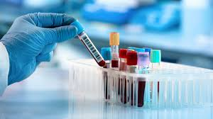
Objectives of Specimen Collection in NGS
To preserve the integrity of nucleic acids (DNA or RNA) in the collected sample.
Minimize degradation
Preserve biological information for downstream analysis.
To obtain high-quality DNA/RNA
To minimize contamination
Ensure reproducibility and consistency
Facilitate/ enhance accuracy of downstream analysis
Compliance with regulatory requirements.
Privacy and rights of study participants

Slide 5
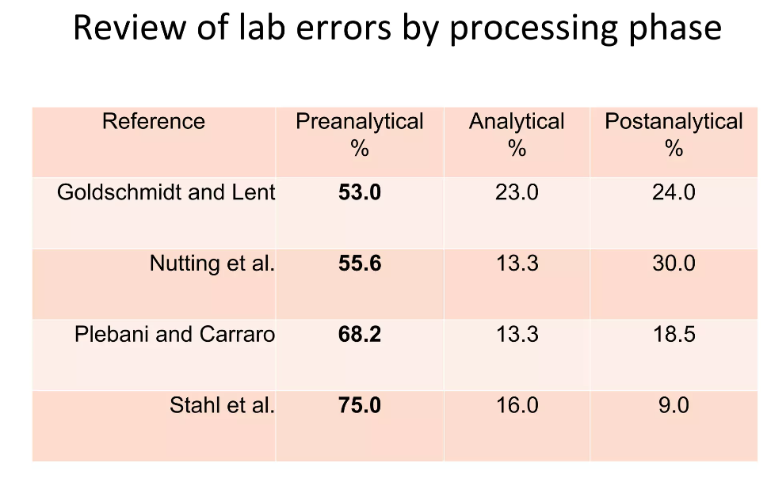
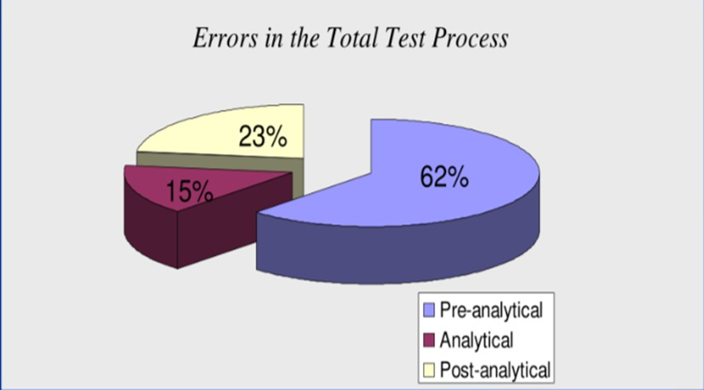
Importance of proper sample collection
Specimen collection is the most integral aspect of the pre-analytical phase
Studies have shown that the pre-analytical errors make up to 53-75% of all laboratory errors.
Notes:
Plebani M. Quality indicators to detect pre-analytical errors in laboratory testing. Clin Biochem Rev. 2012;33(3):85–8.

Slide 6
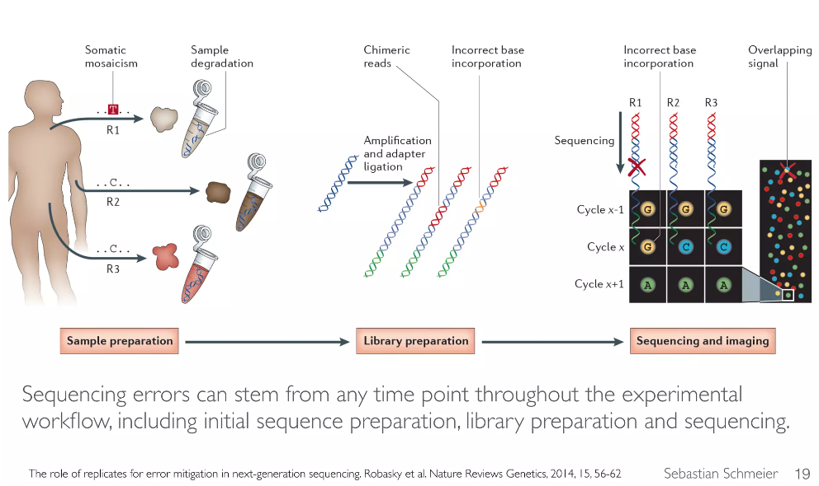
Common errors in the pre-analytical stage
Inappropriate sample volume
Poor sample collection techniques
Poor sample handling and processing
Poor sample quality
Contamination
Degradation
Poor sample storage conditions
Inappropriate choice fixative/preservative

Slide 7
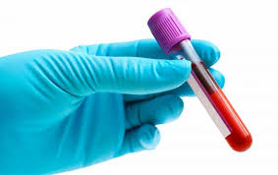
Best Practices for Specimen Collection
Selection of Collection Method
Type of specimen ie blood, tissue, saliva
Sample volume
Quality of sample collection material
Minimize contamination and ensure sample integrity
Target analyte - DNAse & RNAse free materials.
Consider if your collection material contains substances that affect downstream processes ie. Heparin affects PCR.
Proper Sample Handling
Prevent contamination
Handle samples gently to avoid shearing DNA or degrading RNA.
Documentation
Date and time of collection
Sample labeling

Slide 8
Types of Specimens for NGS
Specimens are collected for extraction of nucleic material (DNA & RNA).
Blood: Whole blood samples are commonly used for genetic testing and cancer research.
Blood is suitable for studies on genetic variations and somatic mutations.
Tissue: Tissue samples are mainly biopsies or surgical specimens.
They are valuable for studying genetic mutations associated with diseases like cancer.
They offer a snapshot of the genetic landscape within specific tissues.
Other common samples: Saliva, swabs, sputum, urine, stool, hair and other body fluids like cerebrospinal fluid, and amniotic fluid.

Slide 9
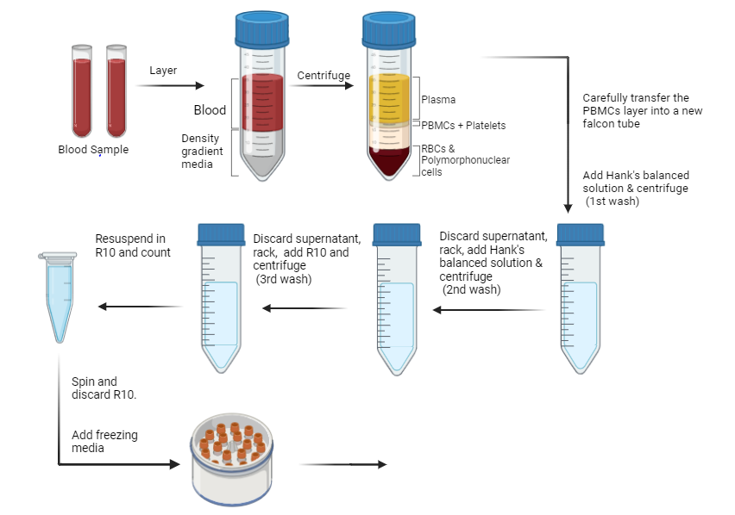
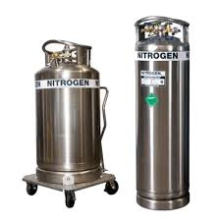
Blood sample
Blood samples for RB genetic testing will be collected in EDTA (Ethylene Diamine Tetraacetic Acid) or ACD (acid-citrate-dextrose) tubes.
PBMCs will then be isolated from the blood and stored at -198 liquid nitrogen tanks.
-80 C
Mr. Frosty

Slide 10
Sample storage
Proper storage conditions maintain nucleic acid stability, minimize degradation, and prevent contamination.
Factors Influencing Sample Storage:
Temperature: recommended temperatures (-80°C for long-term storage, -20°C for short-term storage)
Storage Containers and Materials:
Use inert and non-reactive storage containers (e.g., cryovials, microcentrifuge tubes)
Ensure containers are properly sealed to prevent sample contamination or evaporation.
Use specialized storage solutions (e.g., RPMI) for preserving sample integrity during storage
Sample labelling and Documentation:
Clearly label storage containers with unique identifiers, sample type, collection date, type of collection tube and any relevant data.
Maintain detailed documentation of sample storage conditions ie. temperature logs
Monitoring and Maintenance:
Regularly monitor storage conditions (e.g., temperature)
Conduct preventive maintenance and calibration of storage equipment to optimize performance and reliability.

Slide 11
Quality control measures
SOPs – Sample requisition, sample processing
Study protocol
Description of the study
Objectives
Study population
Staff responsibilities/ competence
Patient and sample identification.
By clinical team - using four identifiers (eg, patient demographics).
Blinded team (Lab team) – Patient unique identifier, study ID
Specimen
Quality
Time of collection (PBMCs should be processed and stored within 6hrs)
Type of vacutainer
Packaging
Fixation requirements for tissues

Slide 12
High quality sample
Best ever sequencing run
High quality results

Slide 13






